Slide 1

Introduction to Google Colaboratory (Colab)

Slide 2
Objectives
In this introduction, you will learn how to;
Create a Google Colab notebook.
Use a Google Colaboratory notebook.

Slide 3
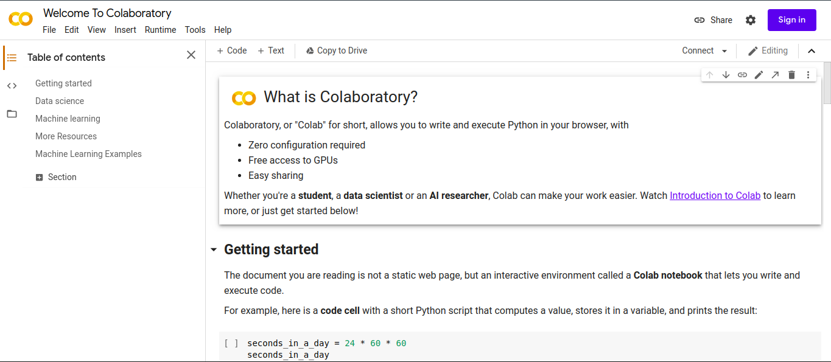
Go to https://colab.research.google.com/

Slide 4

Create a Gmail Account to use
Go to https://www.google.com/gmail/, Click on the create account button and follow the prompts.

Slide 5

Using a Google Account, sign into Colab
Go to https://colab.research.google.com/, and sign in with your Google account.
Click on the ‘NEW NOTEBOOK’ button to create a new notebook.

Slide 6
Using Colab Notebooks
The Colab Home Page is an easy to use and comprehensive tutorial on how to use Colab.
Follow https://colab.research.google.com/notebooks/intro.ipynb to get started.

